Slide 1
QUADRES: QUAntification of Dystrophin Restoration by Exon Skipping
Virginia Arechavala Gomeza
BioCruces Health Research Institute

Slide 2
Nuestro grupo de un vistazo
Enfermedad Rara
Distrofia muscular de Duchenne
Modelo de cultivo celular
Cultivos primarios de piel y músculo
Terapia
Oligonucleótidos antisentido
Medicamento aprovado por la FDA: ETEPLIRSEN (salto del exón)
Expertos
Cuantificación de distrofina
Técnicas novedosas
In Cell Western

Slide 3
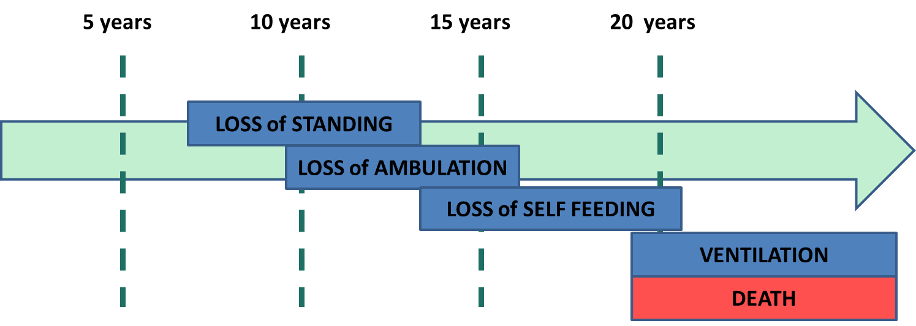
Distrofia muscular de Duchenne
Déficit de distrofina en el músculo
Nuevos medicamentos: restaurar expresión
  Ataluren PTC mutaciones nonsense
  Eteplirsen salto del exón

Slide 4
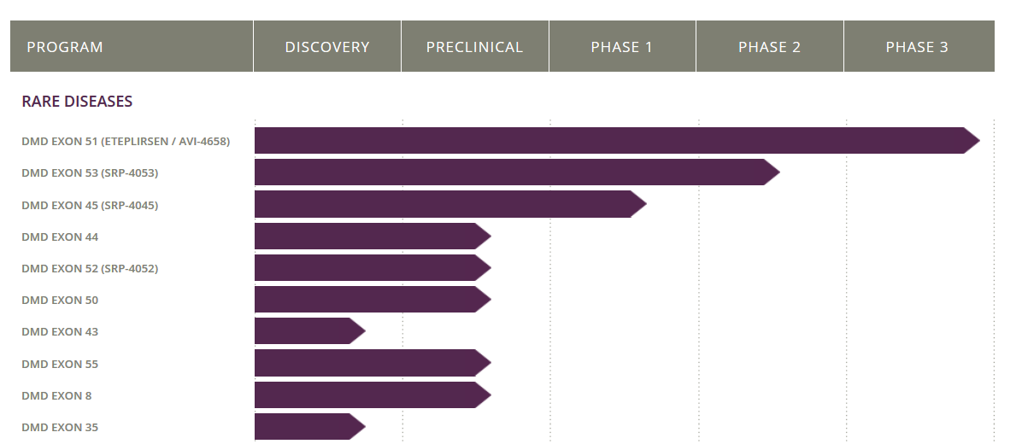
Terapia de salto del exón
Exon 1-43
Deletion of 45
Exon 48-79
44
Pre-mRNA
44
47
46
47
Splicing
A
G
A
G
A
A
G
G
C
U
U
G
C
A
AO
A
U
Translation
Distrofina mas corta, pero funcional

Slide 5
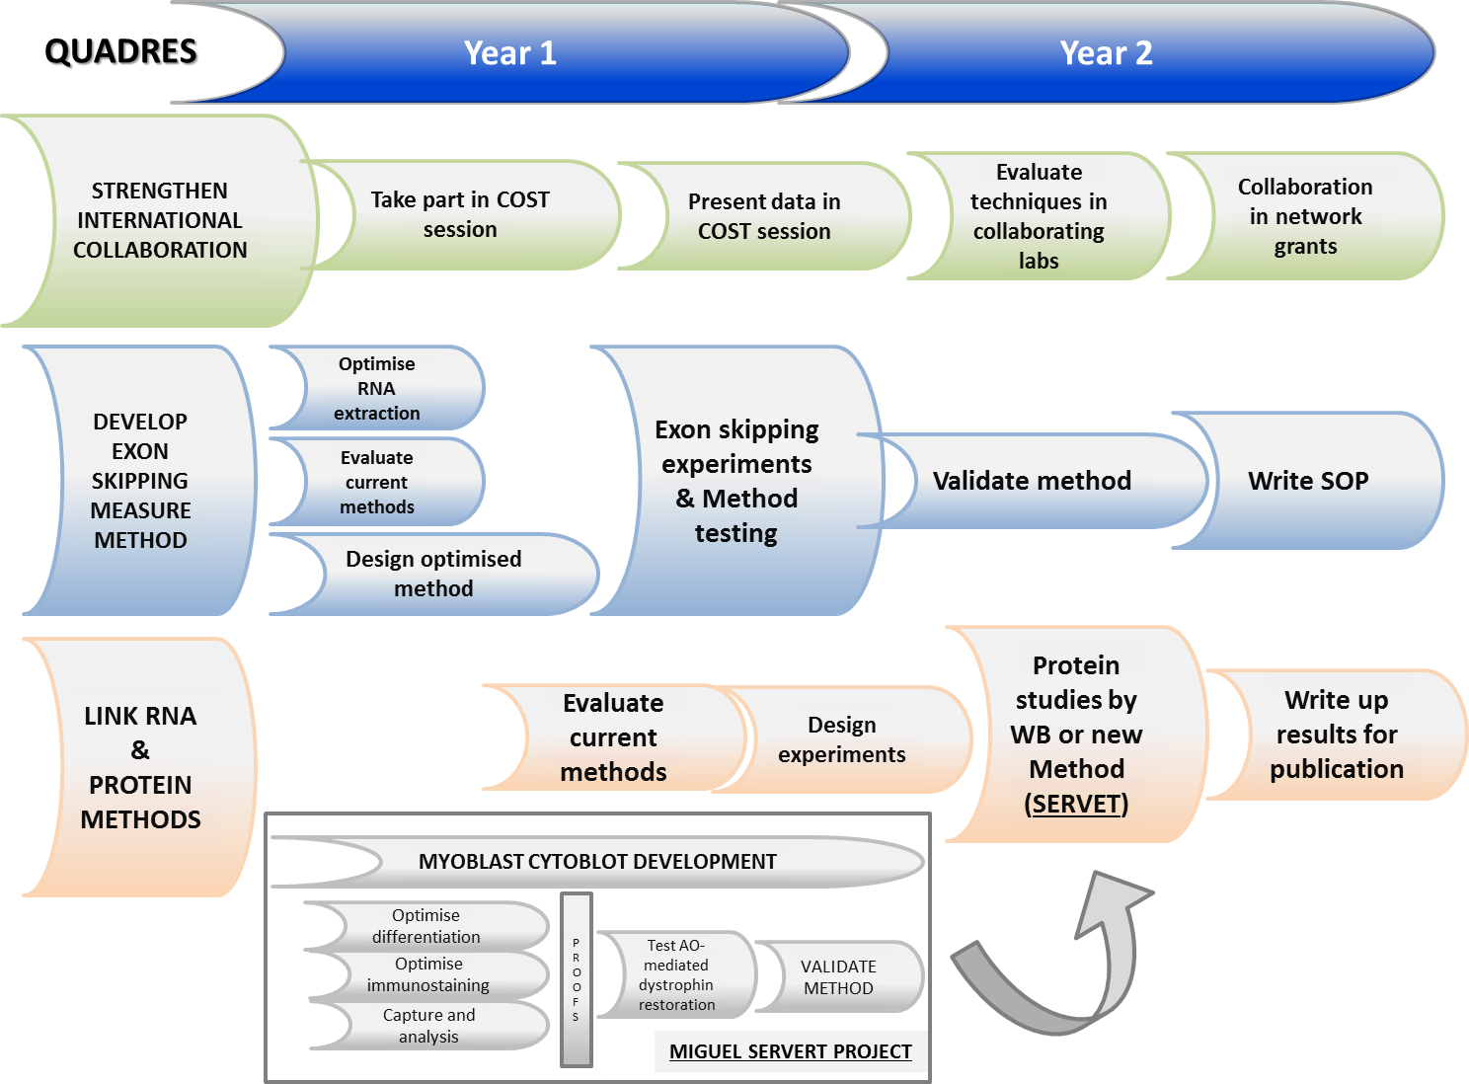
STANDARD SELECTION OF AOS
“In silico” design of sequences
Best sequences compared
“in vitro”
Candidate sequence selected
Toxicology assays
Clinical trial
Software predicts best sequence
Compared in Control and DMD cultures
Methods currently used
Methods currently used
Research at BioCruces
Software
RT-PCR
(not quantitative)
Western Blotting (limited too many cells needed)
Develop quantitative exon skipping measure method
QUADRES
Develop quantitative protein measure method
MIGUEL SERVET PROJECT

Slide 6

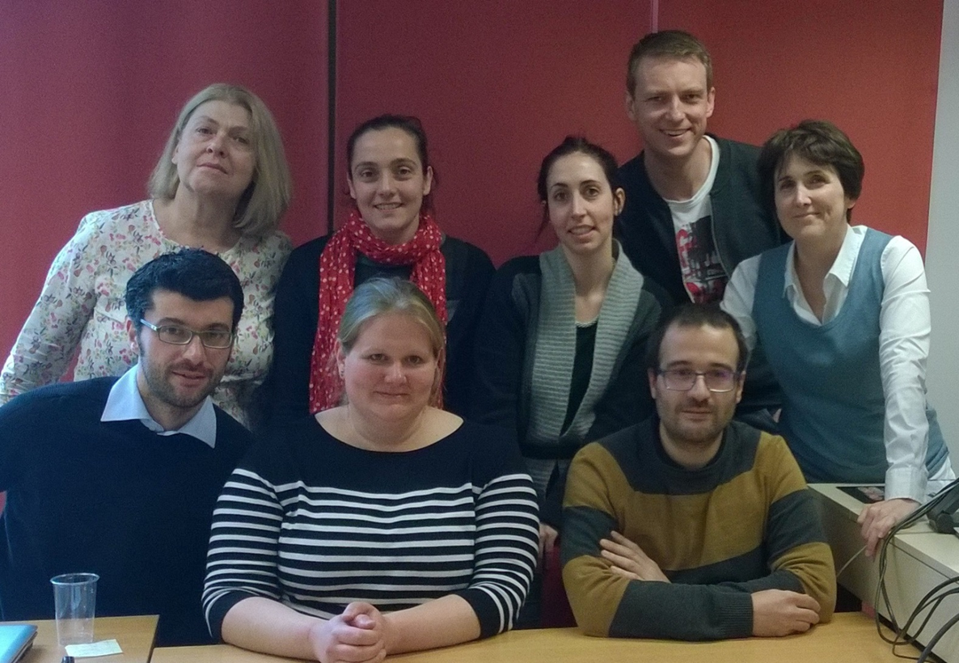
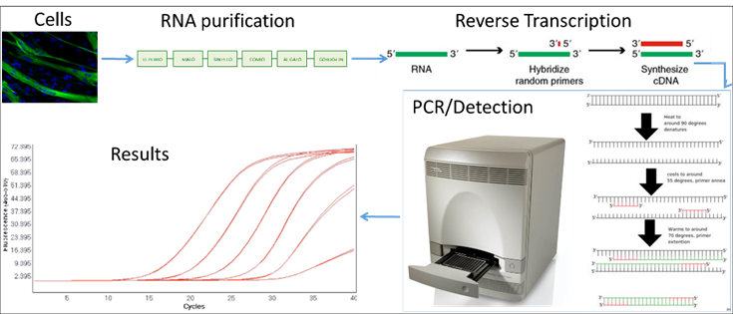






COLABORACIÓN PARA CONSENSUAR MÉTODOS
Colaboración internacional en red COST BM1207:
CONCLUSIONES:
ddPCR: PCR digital. Método más preciso
GeneTools: PCR convencional con reamplificación. Alta variabilidad
ImageJ: PCR convencional con reamplificación. Alta variabilidad
Bioanalyzer: PCR convencional sin reamplificación. Método alternativo (segundo más preciso)

Slide 7
QUADRES
Year 1
Year 2
STRENGTHEN INTERNATIONAL COLLABORATION
Take part in COST session
Present data in COST session
Evaluate techniques in collaborating labs
Collaboration in network grants
DEVELOP EXON SKIPPING MEASURE METHOD
Optimise RNA extraction
Exon skipping experiments & Method testing
Validate method
Write SOP
Evaluate current methods
Selection of Reference genes
Write up results for publication
Design optimised method
Primers modificados con bases DNA y LNA: eliminamos amplificaciones adicionales y detecciones costosas (bioanalyzer, ddPCR).
Validación del método: testado internacional del método posible en el futuro
ddPCR: limitado por altos costes.

Slide 8
QUADRES
Year 1
Year 2
STRENGTHEN INTERNATIONAL COLLABORATION
COST proposal
✓
✓
Take part in COST session
✓
Evaluate techniques in collaborating labs
Collaboration in network grants
Present data in COST session
Fine-tune method
✓
On-going
Exon skipping experiments & Method testing
DEVELOP EXON SKIPPING MEASURE METHOD
Optimise RNA extraction
✓
Validate method
Write SOP
✓
✓
Evaluate current methods
✓
Design optimised method
✓
✓
Selection of Reference genes
Write up results for publication
New section included
LINK RNA & PROTEIN METHODS
✓
✓
✓
✓
Evaluate current methods
Design experiments
Protein studies by WB or new Method (SERVET)
Write up results for publication
MYOBLAST CYTOBLOT DEVELOPMENT
Optimise differentiation
PROOFS
Optimise immunostaining
Test AO-mediated dystrophin restoration
VALIDATE METHOD
Capture and analysis
MIGUEL SERVET PROJECT

Slide 9
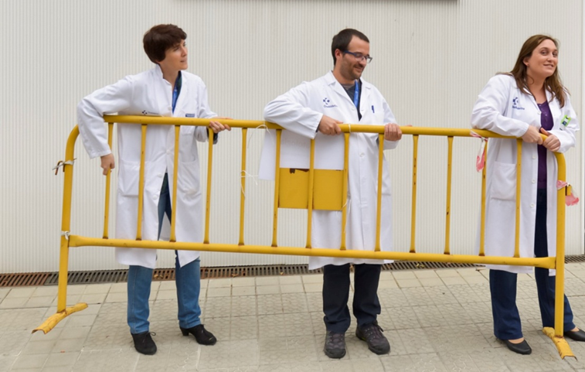










Publicaciones y nuevos proyectos
POSTERS:
Garcia-Jimenez, I., et al. (2016). "Selection of reference genes for normalisation of dystrophin mRNA RT-qPCR data." Neuromuscular Disorders 26: S159-S160.
Ruiz-Del-Yerro, E., et al. (2016). "Myo-cytoblots: Quantification of dystrophin by in-cell western assay for a streamlined development of DMD treatments." Neuromuscular Disorders 26: S159.
ARTÍCULOS
“Selection of reference genes for normalisation of dystrophin expression analyses in cell culture”Iker Garcia-Jimenez, Estíbaliz Ruiz-Del-Yerro, Virginia Arechavala-Gomeza En redacción
“Myoblots: dystrophin quantification by in-cell western assay for a streamlined development of DMD treatments” Estíbaliz Ruiz-Del-Yerro, Iker Garcia-Jimenez, Kamel Mamchaoui, Virginia Arechavala-Gomeza En redacción
“A multicenter comparison of exon 51 skipping quantification in Duchenne muscular dystrophy” M. Hiller, M.S. Falzarano, I. Garcia-Jimenez, V. Sardone, R.C. Verheul, L. Popplewell, E. Ruiz-Del-Yerro, R.H. Vossen, J.J. Goeman, S.Y. Anvar, G. Dickson, A. Ferlini, F. Muntoni, A. Aartsma-Rus, V. Arechavala-Gomeza, N.A. Datson, P. Spitali En redacción
NUEVOS PROYECTOS:
Cuantificación de utrofina en distrofias musculares. Departamento de Salud del Gobierno Vasco. Enero-Diciembre 2017
CRISPR/Cas gene editing of animal model cultures for a faster transfer of DMD treatments to the clinic. Duchenne Parent Project Spain Ene 2017- Dec 2018
Edición genética avanzada para el tratamiento de la Distrofia Muscular de Duchenne¨ (ENiGMA: EdicioN Genetica MusculAr) Proyectos de Investigación en Salud (Instituto de Salud Carlos III), Jan 2016-Dec 2018
www.arechavala-lab.com

